Slide 1




FAMILY &FRIENDS 1
National Edition

Slide 2
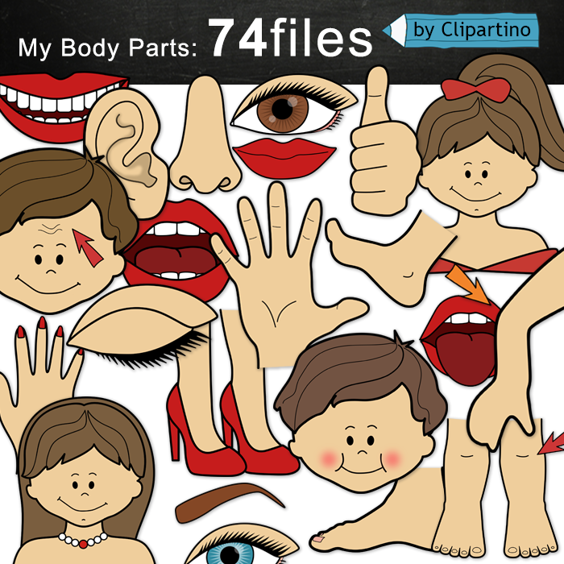
UNIT 5 : THIS IS MY NOSE!
LESSON 1 : WORDS

Slide 3


SIMON
SAYS
Notes:
- Ask students to stand at their desks.
- Tell them the rule: If the instruction begins with the words Simon says, children must do as you say. If not, they should stand still and wait for the next instruction. Students who get this wrong are out of the game and have to sit down.
Simon says point to your desk; Simon says stand up; Simon says write your name; Sit in your chair; touch your desk, count to 3,…
- Continue the game until there is one winner left standing, or a group of winners if you prefer

Slide 4

Notes:
- Ask students to stand up, sing along and dance

Slide 5


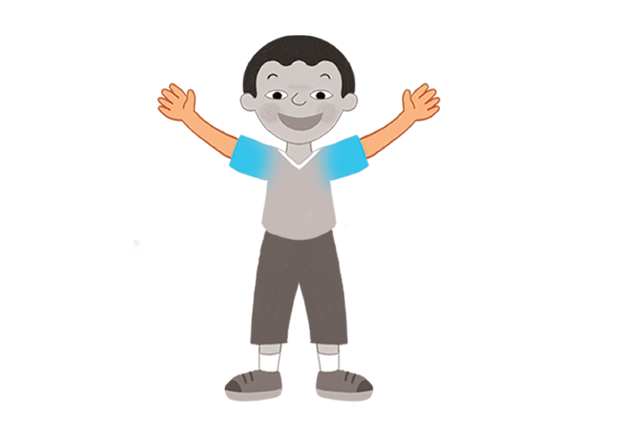

Notes:
- Ask: What’s this?
- Say the words for children to repeat in chorus.
- Put Flashcards 32-37 in different places around the room.
- Say a word.
- Students point to the card and repeat the word in chorus.

Slide 6
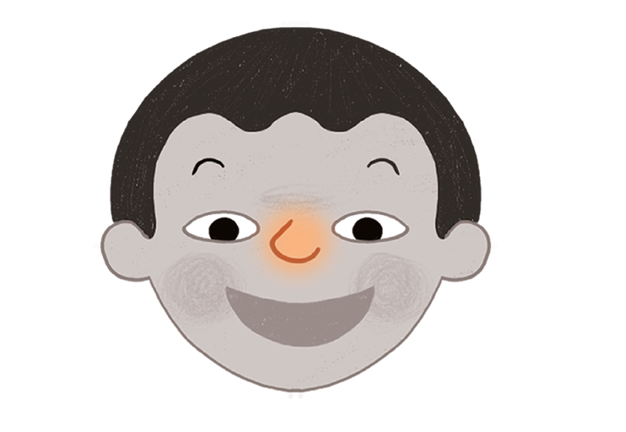

Slide 7
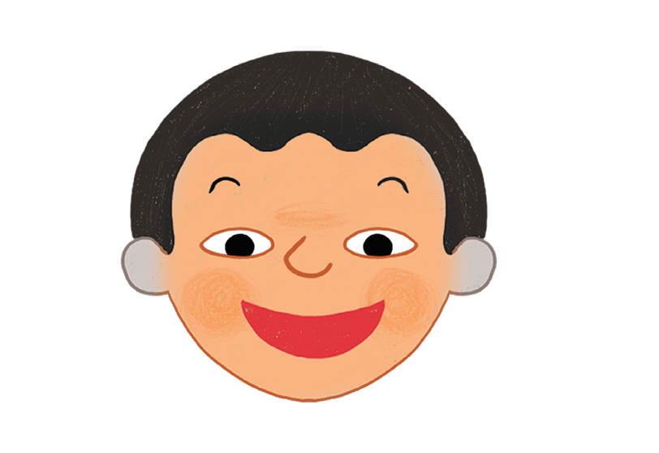

Slide 8
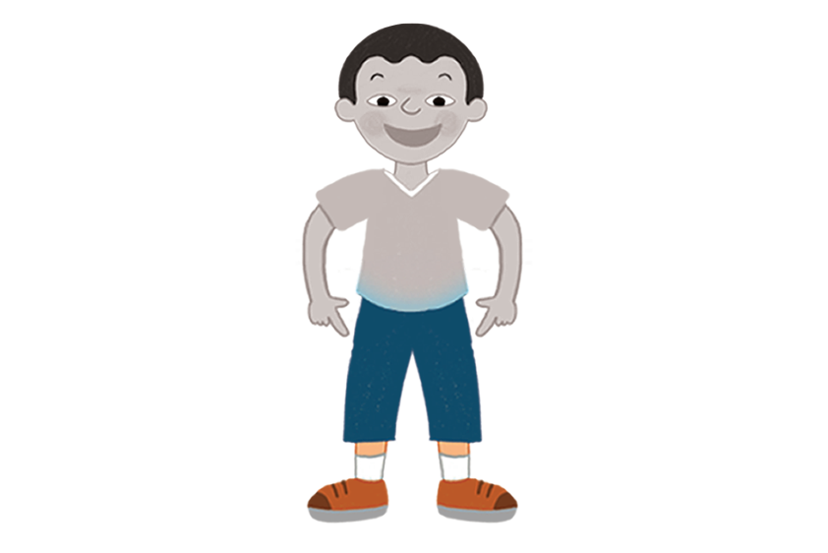

Slide 9
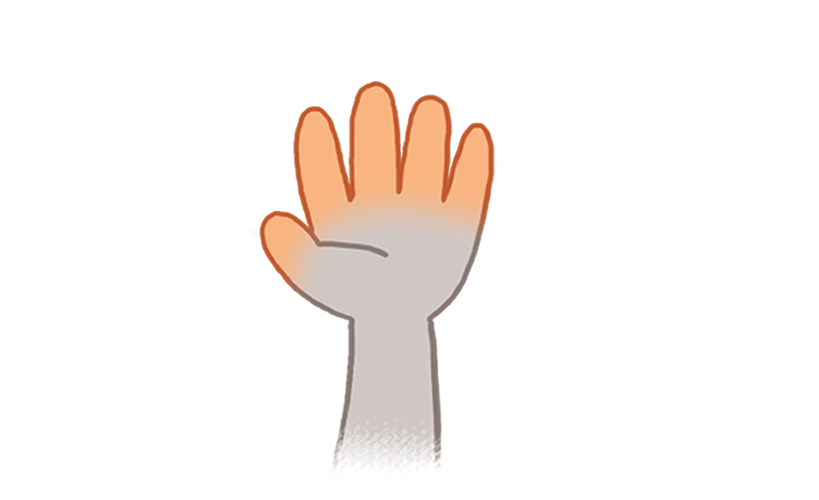

Slide 10
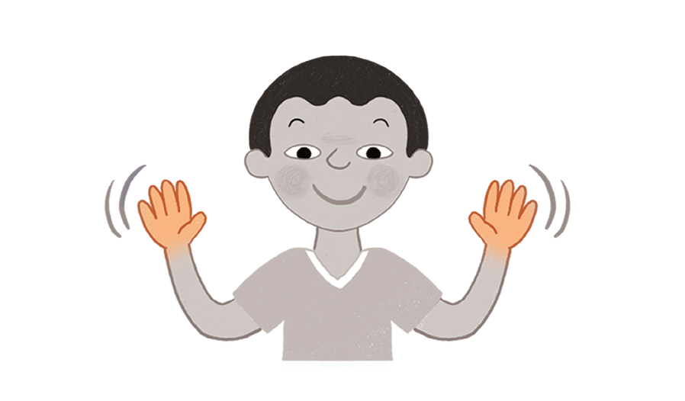


Slide 11






Notes:
Listen and point. Track 61
- Play track 61, listen and point
- Play again, ask students to listen and point
- Play again, ask students to listen and repeat

Slide 12

Notes:
Listen and chant. Track 62
- Students listen to track 62
- Students listen again and point to the correct body parts of their own bodies.
- Play the chant again for them to say the words.

Slide 13









Slide 14
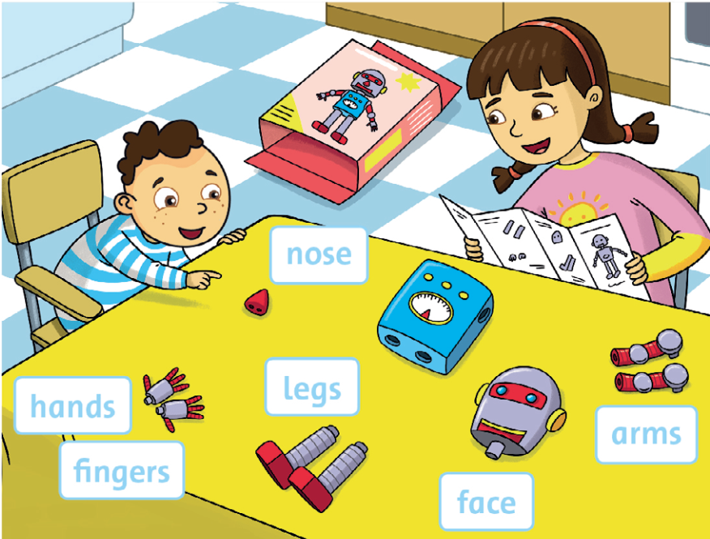

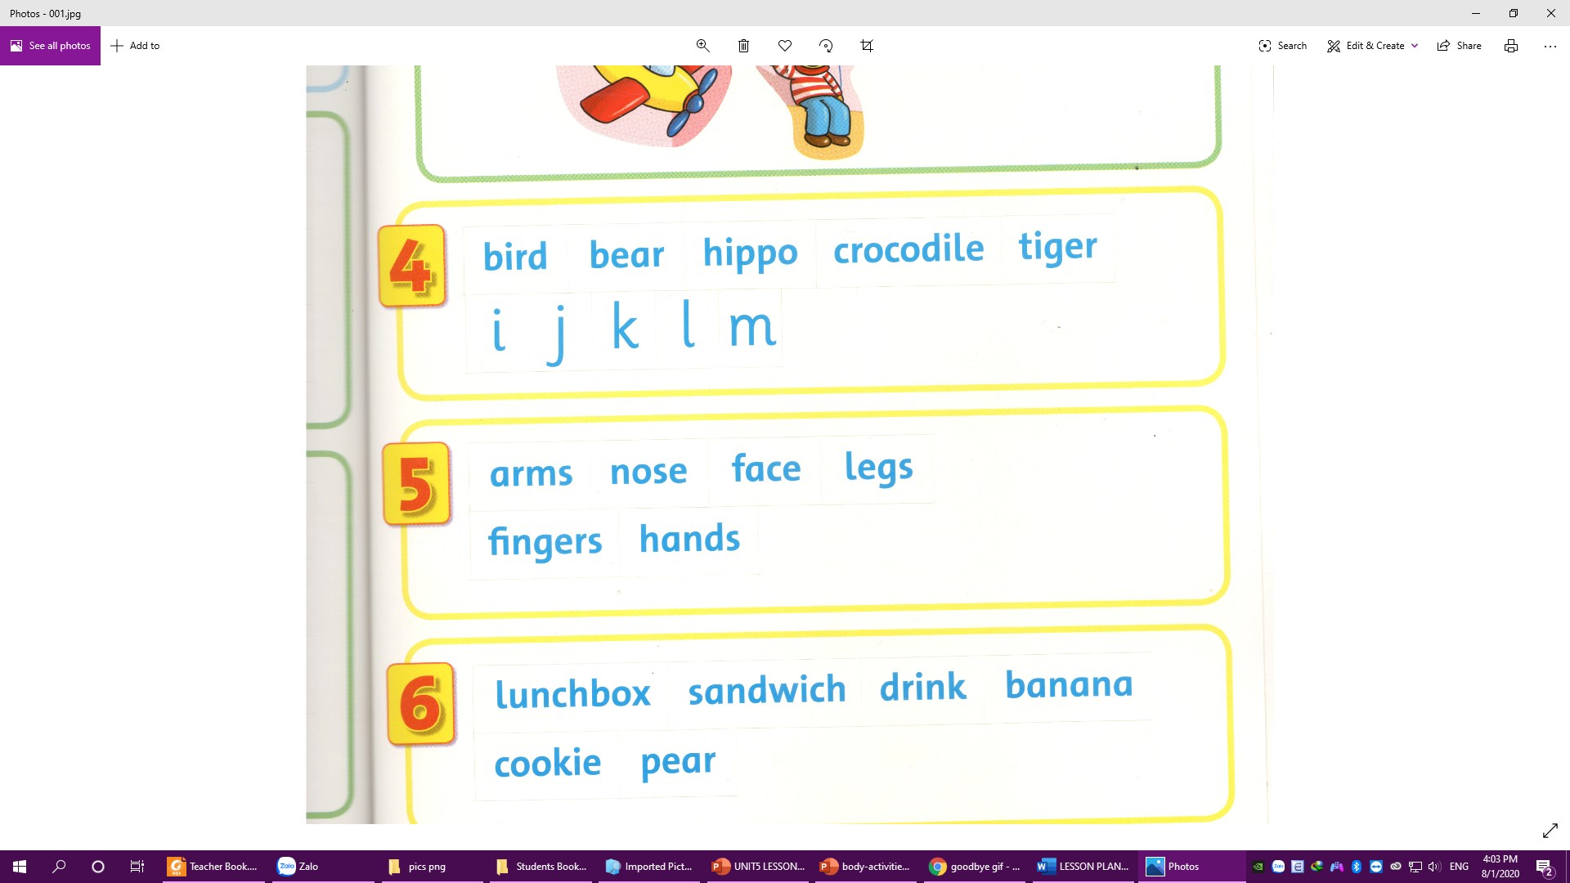




Notes:
Point and say. Stick
- Point to the pictures and say: arms.
- Ask students to repeat.
- Say: Let’s read!
- Students say in chorus and then individual.
- Say: Let’s stick!
- Stick the sticker and say: Arms.
- Ask students to work in pairs to say and stick
- Go around to help

Slide 15

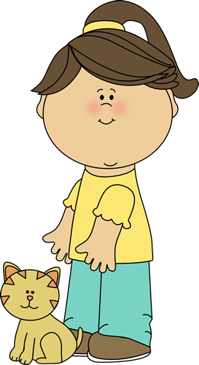






Slide 16





Slide 17
face

Slide 18





Slide 19
fingers

Slide 20




